Slide 1
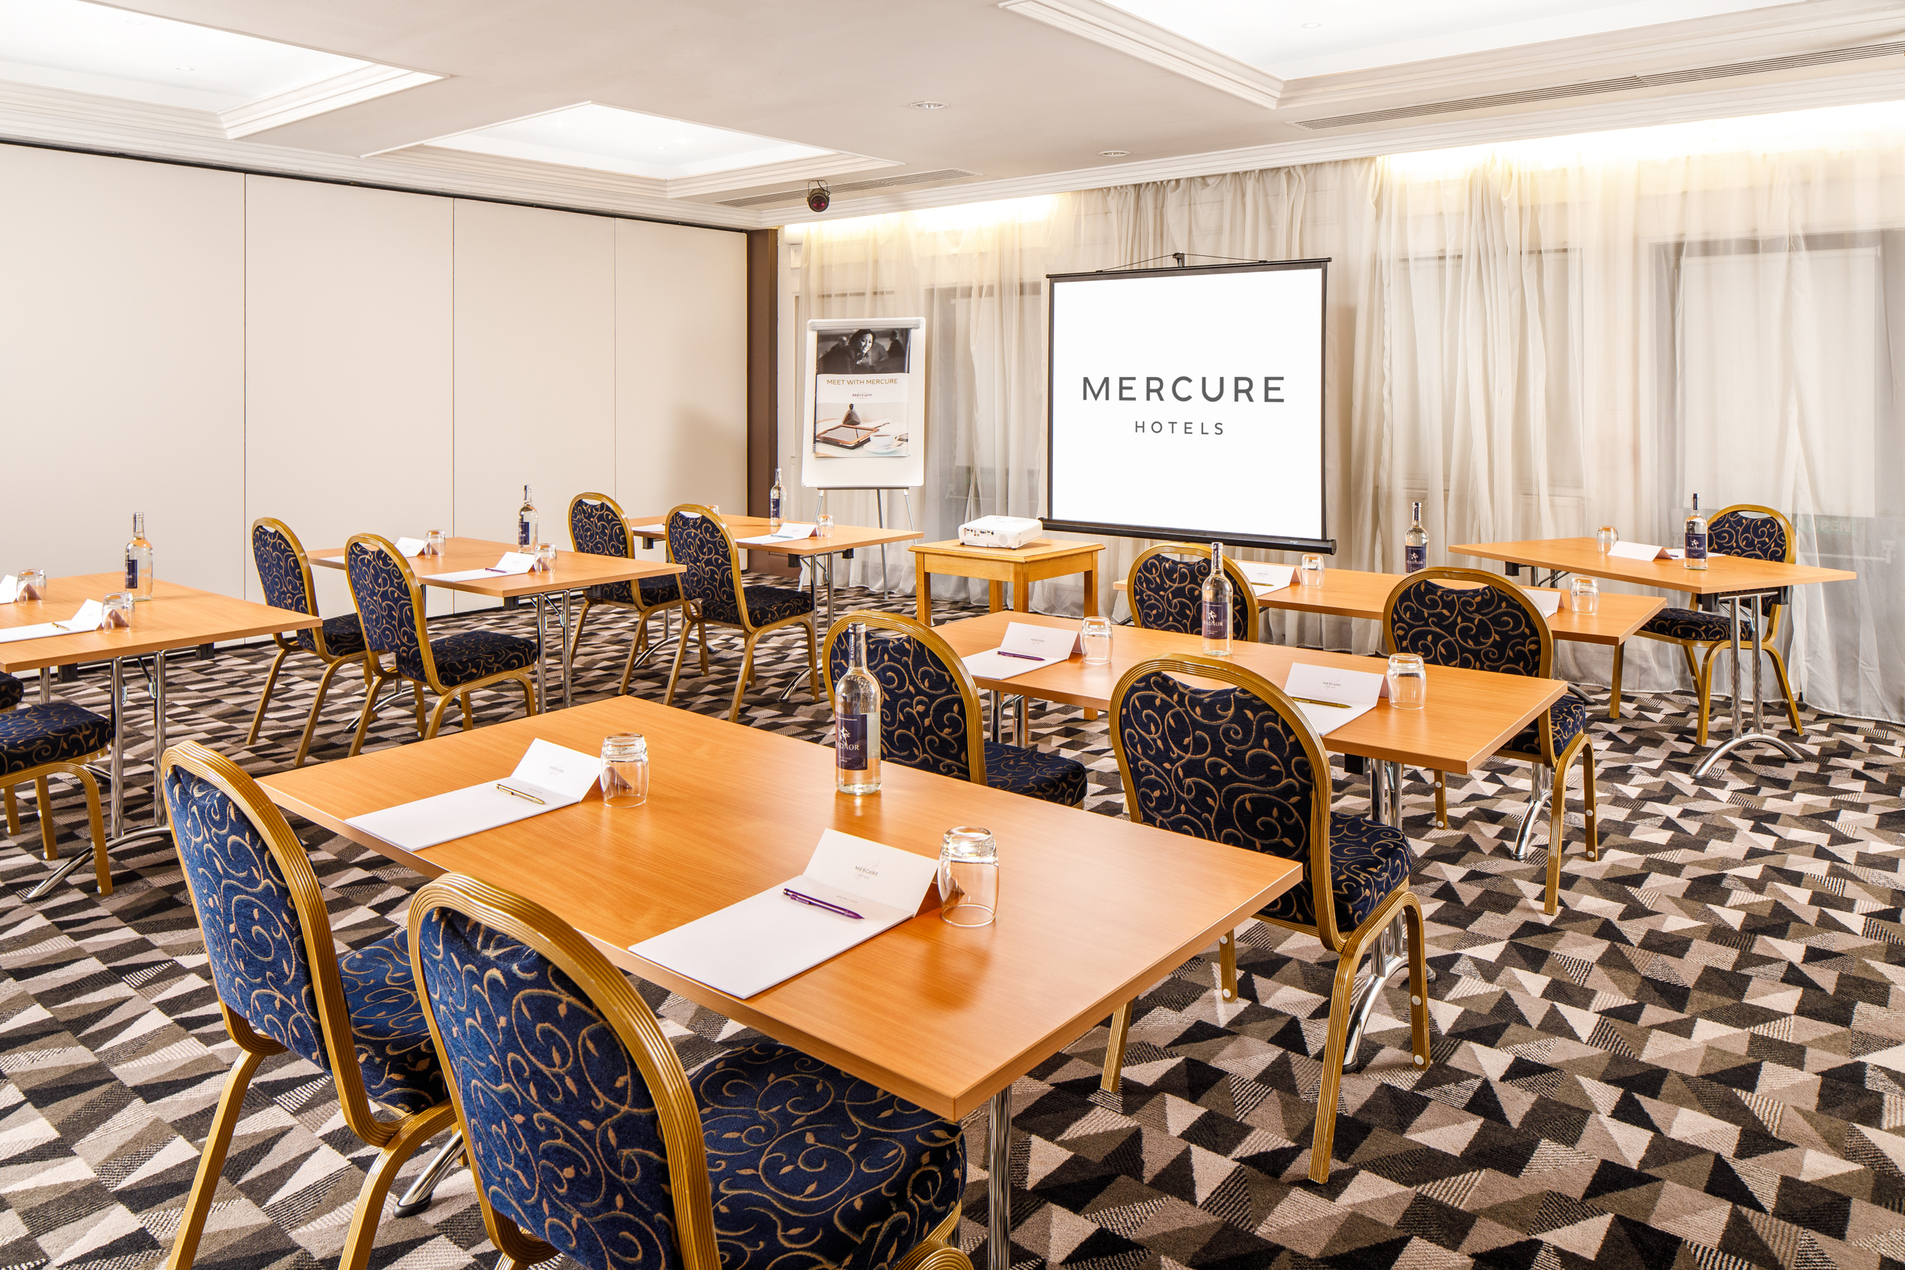
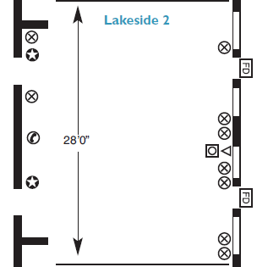

LAKESIDE 2
Part of the Lakeside Suite. Located on the ground floor, the Lakeside Two is accessible to all.
Key Information
Floor | Ground
Disabled access | Yes
Natural Daylight | Yes
Air Conditioning | No
Setup | Capacity
Theatre | 40
Cabaret | 24
Boardroom | 30
Classroom | 20
U-shape | 30
Dinner | 30
Room Dimensions
Height | 2.47m
Length & Width | 8.56m x 7.03m
Square Metres | 60.18

